Slide 1
MAY FINANCIAL/ ENROLLMENT REPORT
Board Meeting May 23, 2024

Slide 2
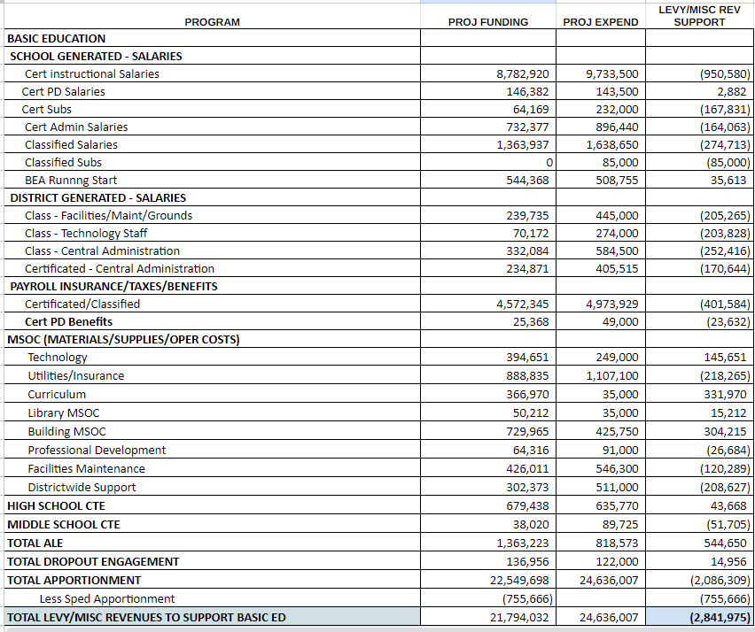
PROJECTED REVENUES, EXPENDITURES AND ENDING FUND BALANCE - BEA/DIST SUPPORT

Slide 3
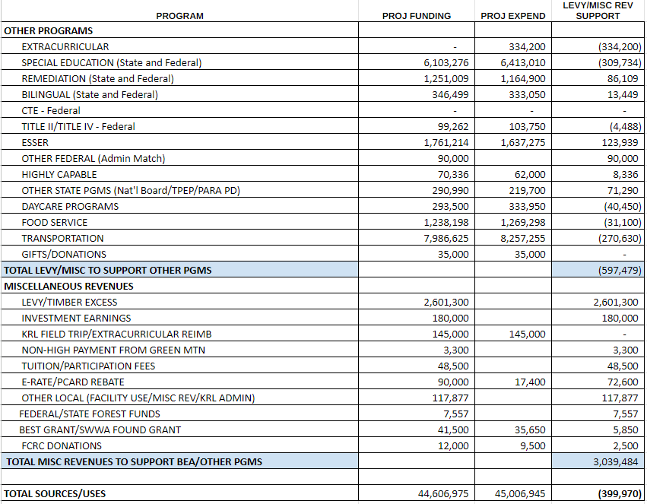
PROJECTED REVENUES, EXPENDITURES AND ENDING FUND BALANCE - OTHER PROGRAMS AND MISC REVENUES

Slide 4
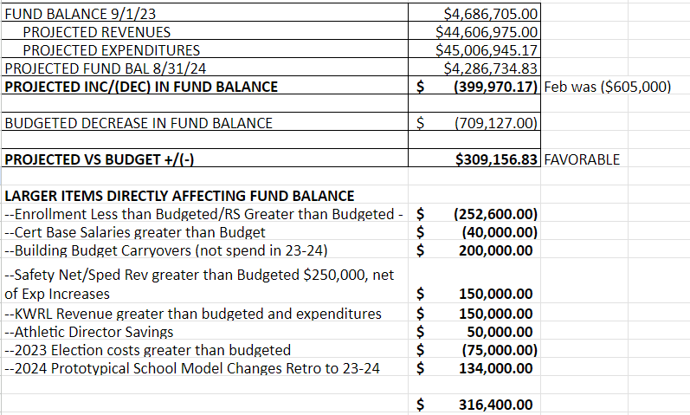
PROJECTED REVENUES, EXPENDITURES AND ENDING FUND BALANCE - SUMMARY

Slide 5
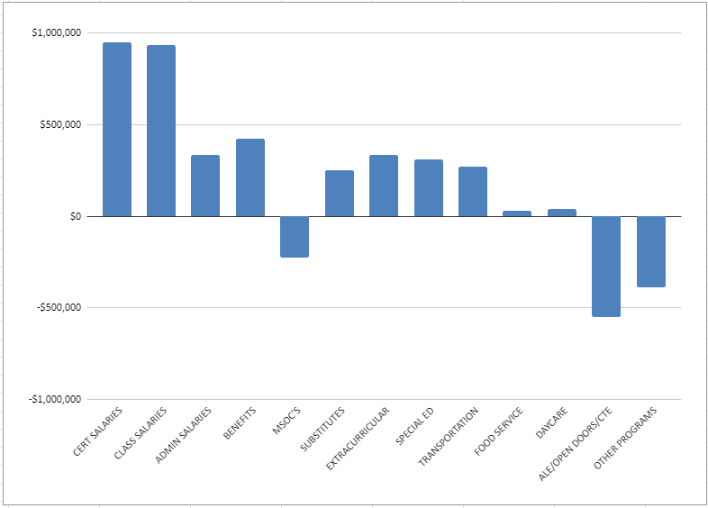
LEVY/MISC FUNDS SPENT - BY CATEGORY

Slide 6
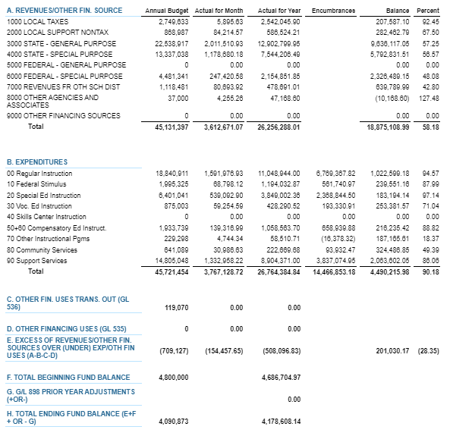
MARCH 2024 BUDGET STATUS REPORT – GENERAL FUND

Slide 7
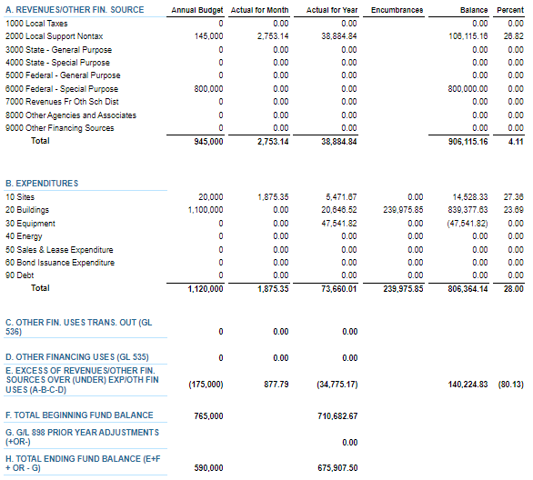
MARCH 2024 BUDGET STATUS REPORT – CAPITAL PROJECTS FUND

Slide 8
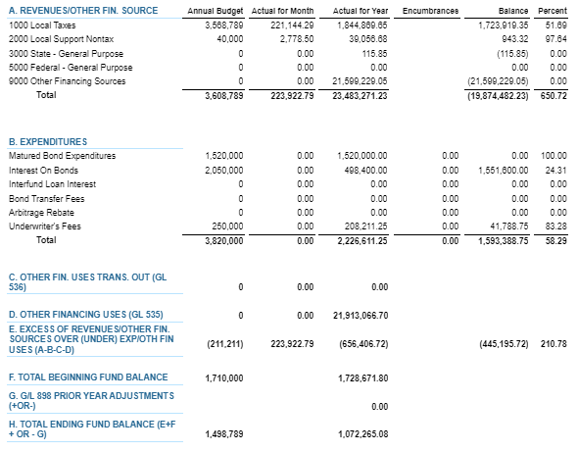
MARCH 2024 BUDGET STATUS REPORT – DEBT SERVICE FUND

Slide 9
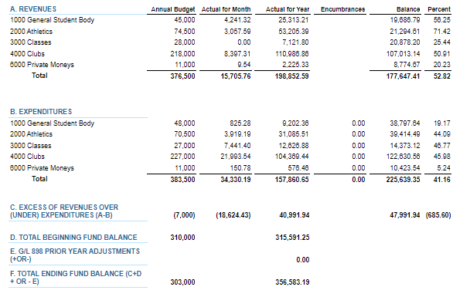
MARCH 2024 BUDGET STATUS REPORT – ASB FUND

Slide 10
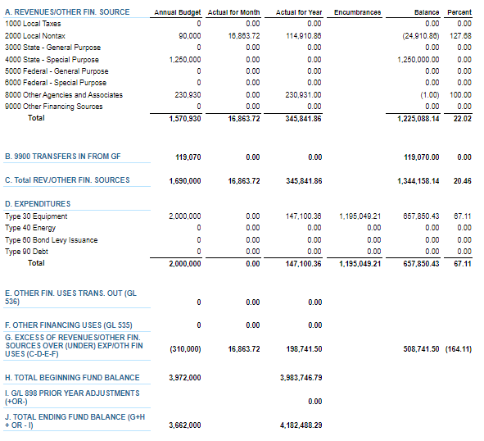
MARCH 2024 BUDGET STATUS REPORT – TRANSPORTATION VEHICLE FUND

Slide 11
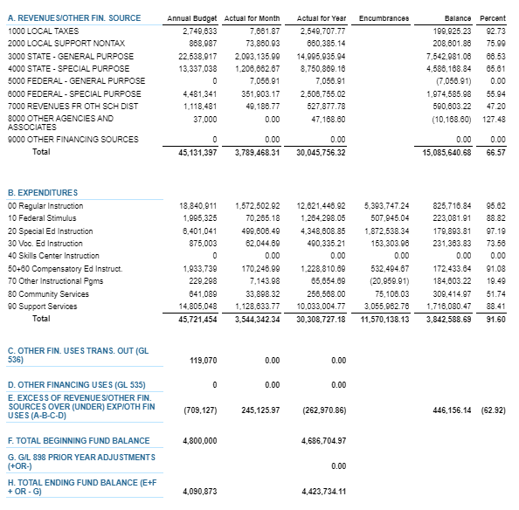
APRIL 2024 BUDGET STATUS REPORT – GENERAL FUND

Slide 12
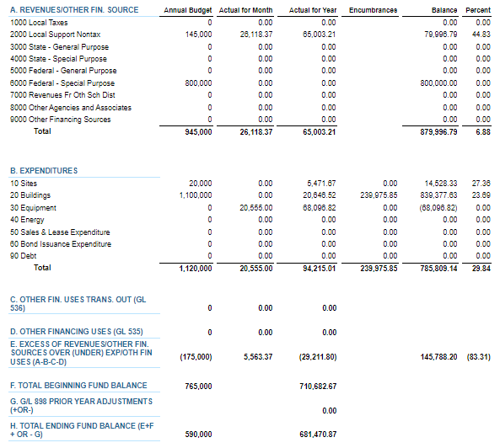
APRIL 2024 BUDGET STATUS REPORT – CAPITAL PROJECTS FUND

Slide 13
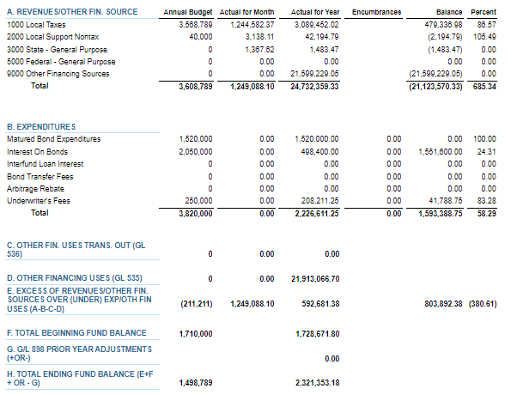
APRIL 2024 BUDGET STATUS REPORT – DEBT SERVICE FUND

Slide 14
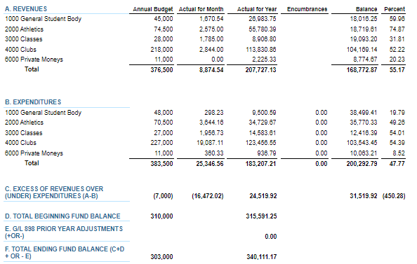
APRIL 2024 BUDGET STATUS REPORT – ASB FUND

Slide 15
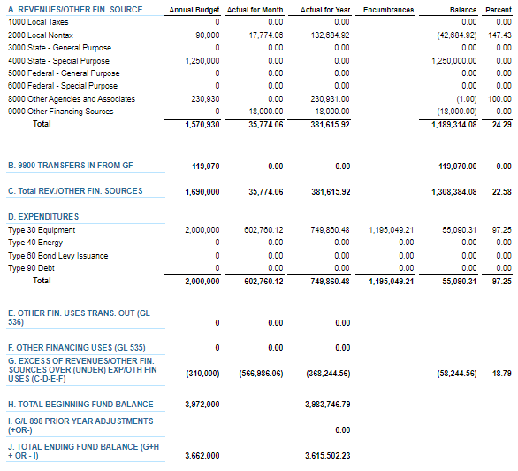
APRIL 2024 BUDGET STATUS REPORT – TRANSPORTATION VEHICLE FUND

Slide 16
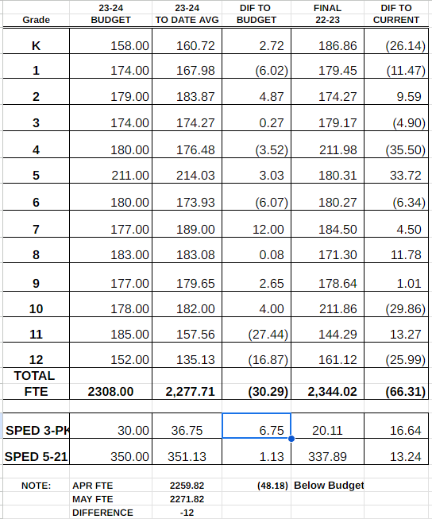
FTE ENROLLMENT – MAY 2024

Slide 17
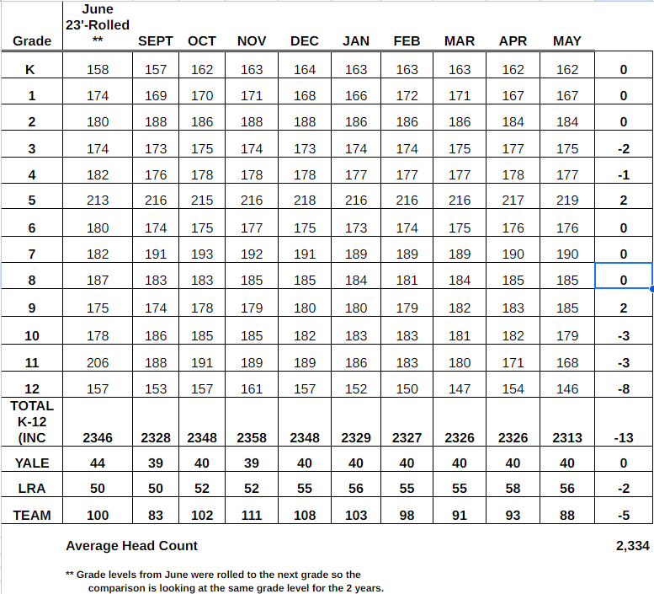
HEADCOUNT ENROLLMENT – MAY 2024

